Slide 1
Numerical simulation of phase change using enthalpy methods
Galen Jackson
Yash Ganatra

Slide 2
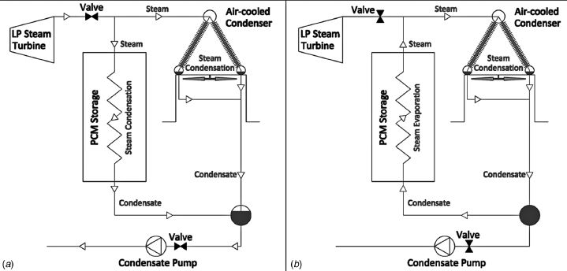
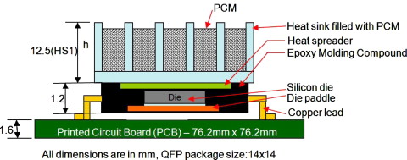
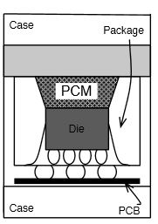
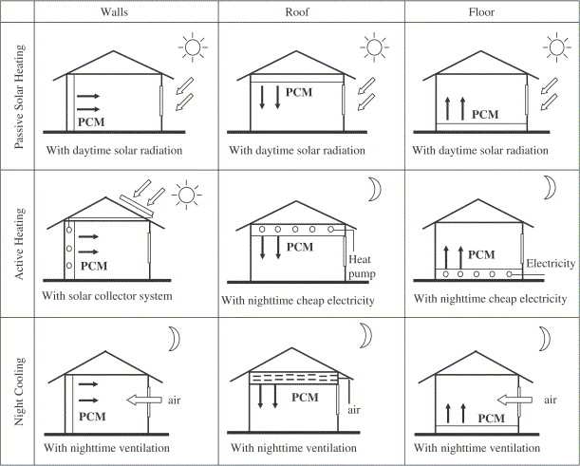
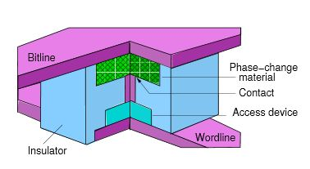
Key Applications
Concentrated Solar Power Plants
Electronics Cooling
Integrate with heat sinks at device
level
Motta et al.
J. Sol. Energy Eng, 2011
Majumdar, et al.
Appl Thermal Engineering, 2008.
At Package level
Smart Buildings
Phase Change Memory
Raghavan, et al.
Proc HPCA, 2012
Quereshi et al.
ACM SIGARCH, 2009

Slide 3
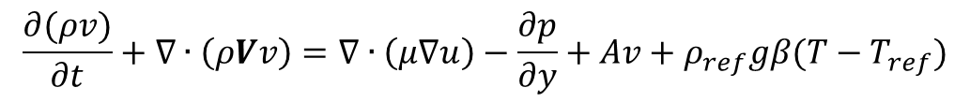
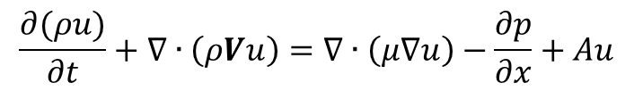
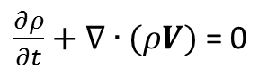
Conservation of linear momentum (COLM)
Governing equations:
Boussinesq approximation: Density only varies in gravity source term
Correction factor for solid region
$$\frac{∂(ρu)}{∂t}+∇∙\left(ρVu\right)=∇∙\left(μ∇u\right)−\frac{∂p}{∂x}+Au$$
$$\frac{∂(ρv)}{∂t}+∇∙\left(ρVv\right)=∇∙\left(μ∇u\right)−\frac{∂p}{∂y}+Av+ρ_{ref}gβ(T−T_{ref})$$
0
$\frac{∂ρ}{∂t}+∇∙(ρV)$ = 0

Slide 4
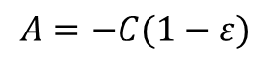
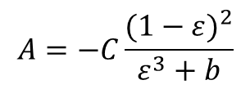
Enthalpy-porosity method: COLM
The enthalpy-porosity method effects the COLM equation by assuming the melting region as a porous structure, in a similar form to the Carman-Kozeny equation:
C: Constant of porous region ε: Liquid/Solid fraction
Can be simplified into linear equation
$$A=−C\frac{{(1−ε)}^{2}}{ε^{3}+b}$$
$$A=−C(1−ε)$$

Slide 5
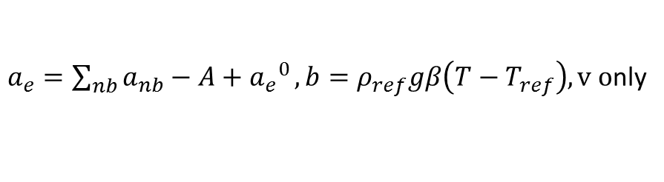
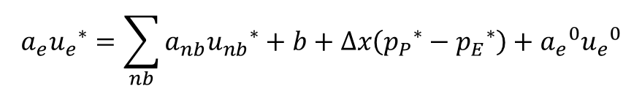
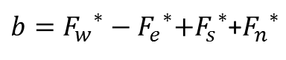
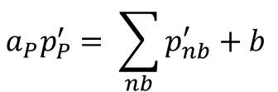
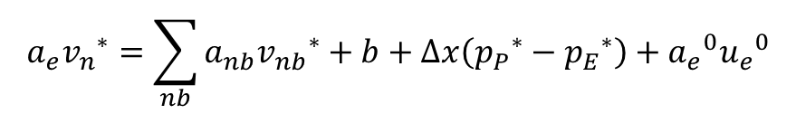
SIMPLE algorithm
COLM solved using SIMPLE algorithm
Pressure correction equation
$$a_{e}{u_{e}}^{∗}=\sum_{nb}{a_{nb}{u_{nb}}^{∗}+b+∆x\left({p_{P}}^{∗}−{p_{E}}^{∗}\right)+{a_{e}}^{0}{u_{e}}^{0}}$$
$$a_{e}{v_{n}}^{∗}=\sum_{nb}{a_{nb}{v_{nb}}^{∗}+b+∆x\left({p_{P}}^{∗}−{p_{E}}^{∗}\right)+{a_{e}}^{0}{u_{e}}^{0}}$$
$a_{e}=\sum_{nb}{a_{nb}−A+{a_{e}}^{0}}, b=ρ_{ref}gβ\left(T−T_{ref}\right), v o$nly
$$a_{P}p_{P}^{′}= \sum_{nb}{p_{nb}^{′}}+b$$
$b={F_{w}}^{∗}−{F_{e}}^{∗}{{+F}_{s}}^{∗}$+${F_{n}}^{∗}$

Slide 6
SIMPLE: Validation
u=U
Lid driven problem (60x60 grid)
Validation against Ghia et al. [1]
u,v=0
u,v=0
u,v=0
Velocity profile for u centerline (left) and v centerline (right)
[1] Ghia et al., High-Re solutions for incompressible flow using the Navier-Stokes equations and a multigrid method
Convergence of SIMPLE algorithm over set iterations

Slide 7
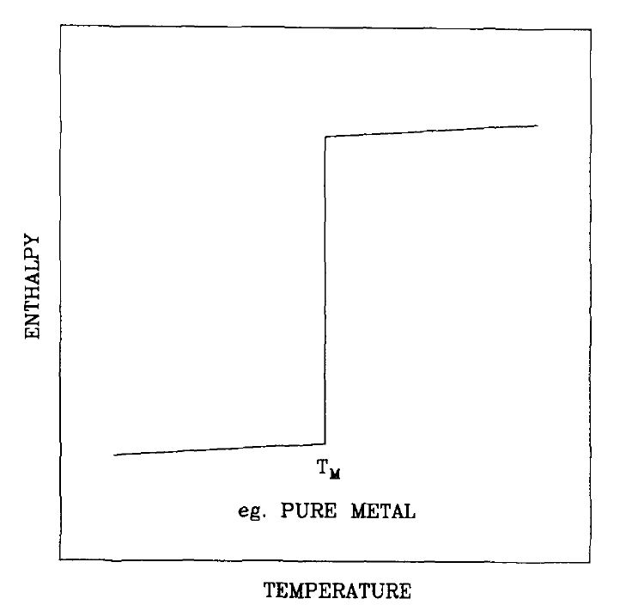
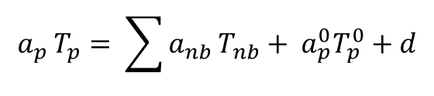
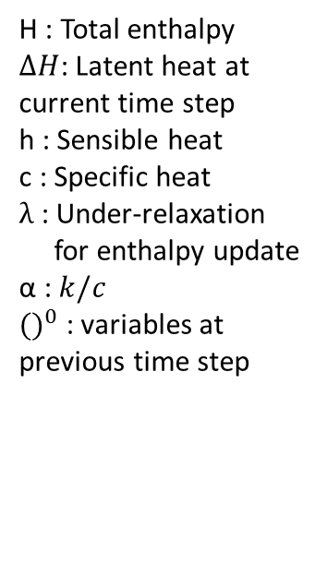
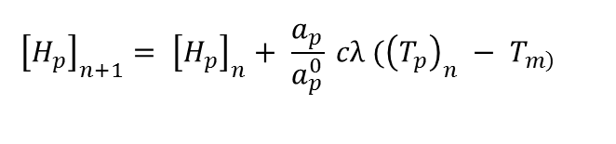
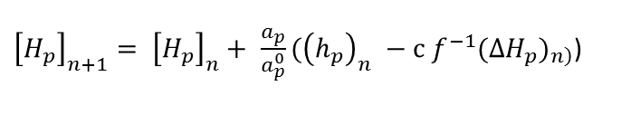
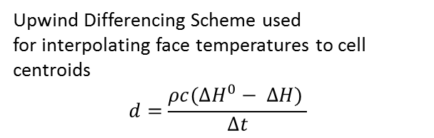
Energy Equation
$$\frac{∂(ρH)}{∂t}+div\left(ρuH\right)=div \left(k ∇T\right)$$
H : Total enthalpy
$∆H$: Latent heat at current time step
h : Sensible heat
c : Specific heat
$λ$ : Under-relaxation
for enthalpy update
α : $k/c$
${()}^{0}$ : variables at previous time step
(1)
$$H=h+ ∆H$$
(2)
S_{h}
Substituting (2) in (1), to get (3),
u = 0
At solid liquid interface
$$\frac{∂(ρh)}{∂t}+div\left(ρuh\right)=div \left(α ∇h\right) − \left(\frac{∂\left(ρ∆H\right)}{∂t}+div (ρu∆H\text{)} \right)$$
(3)
Substituting h= cT, to get (4),
$$\frac{∂(ρcT)}{∂t}+div\left(ρucT\right)=div \left(k ∇T\right) − \left(\frac{∂\left(ρ∆H\right)}{∂t}\right)$$
(4)
Enthalpy Update
Discretization : Fully Implicit scheme
$$a_{p }T_{p}= \sum{a_{nb }T_{nb}}+ a_{p}^{0}T_{p}^{0}+d$$
${\left[H_{p}\right]}_{n+1}= {\left[H_{p}\right]}_{n}+ \frac{a_{p}}{a_{p}^{0}}({\left(h_{p}\right)}_{n} −c f^{−1}{({∆H}_{p})}_{\left.n\right)}$)
Upwind Differencing Scheme used
for interpolating face temperatures to cell centroids
$$d=\frac{ρc({∆H}^{0}− ∆H) }{∆t}$$
$${\left[H_{p}\right]}_{n+1}= {\left[H_{p}\right]}_{n}+ \frac{a_{p}}{a_{p}^{0}} cλ ({\left(T_{p}\right)}_{n} − T_{\left.m\right)}$$
Brent, et al. Num Heat Transfer,1988
Voller. et al. Num Methods in Heat Transfer, 1987
Voller et al.

Slide 8
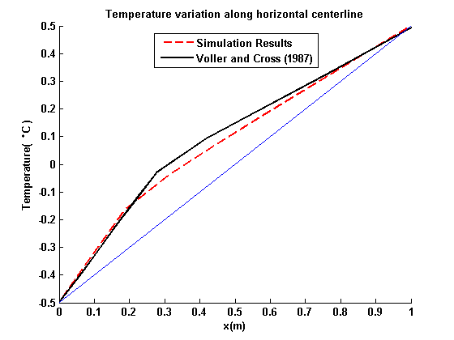
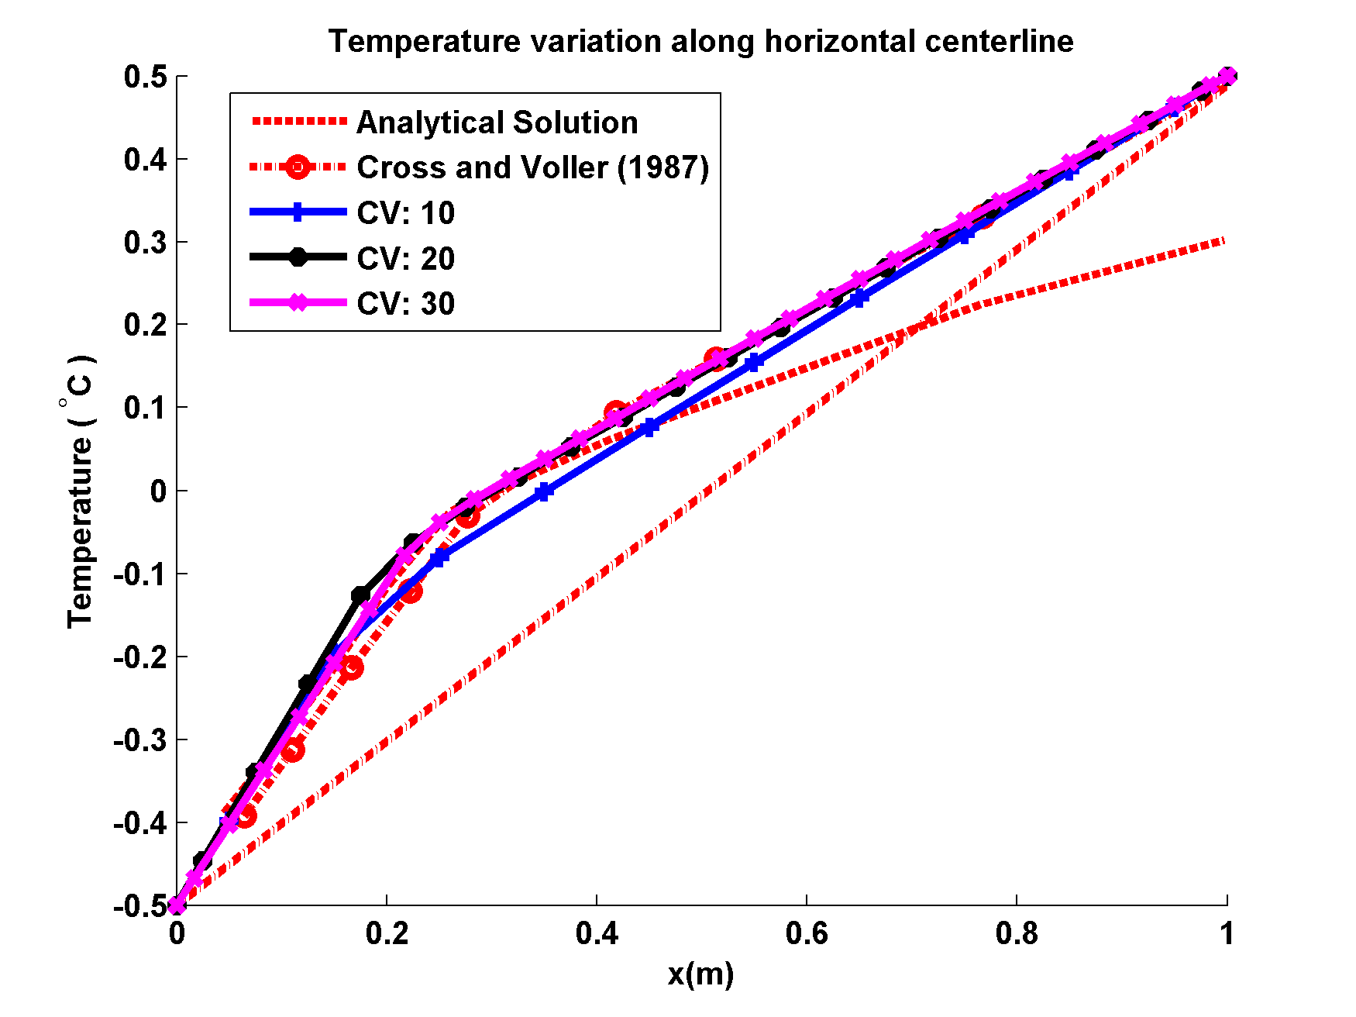
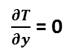
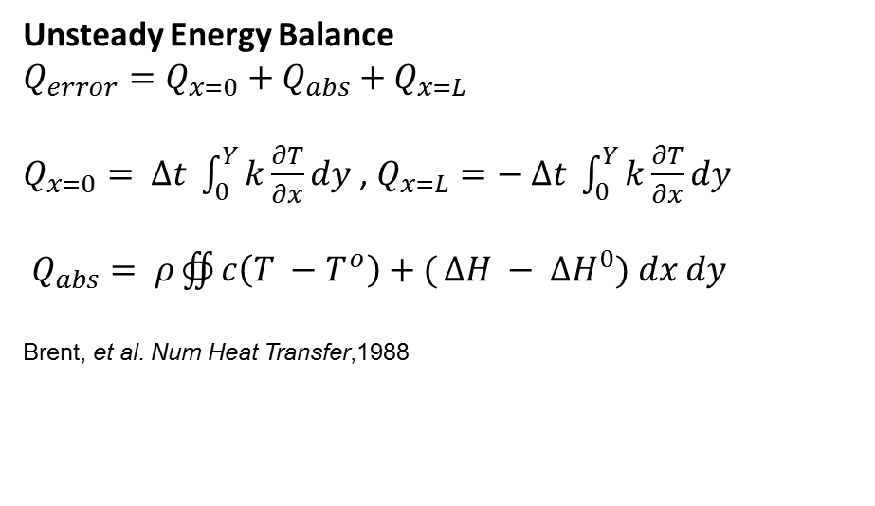
Diffusion Phase Change - Validation
$\frac{∂T}{∂y}$ = 0
1
Solver Tolerance Criteria
Line by Line TDMA: 1e-6
Unsteady Energy Balance: 1e-5
Under-relaxation: 0.9
T = - 0.5
T_{init} = 0.5
T = 0.5
L = 0
k = 0.001
c = 1
L = 5
ρ = 1
T_{ref} = 0
y
1
Voller. et al. Num Methods in Heat Transfer, 1987
O
x
0
$\frac{∂T}{∂y}$ = 0
Comparison of results obtained with 10 CV and
Benchmark simulation results by Voller and Cross (1987)
Voller. et al. Num Methods in Heat Transfer, 1987
Unsteady Energy Balance
$$Q_{error}=Q_{x=0}+Q_{abs}+Q_{x=L}$$
$Q_{x=0}= ∆t \int_{0}^{Y}{k\frac{∂T}{∂x}}dy$ , $Q_{x=L}=− ∆t \int_{0}^{Y}{k\frac{∂T}{∂x}}dy$
$Q_{abs}= ρ∯{c\left(T −T^{o}\right)+(}∆H − {∆H}^{0}) dx dy$
Brent, et al. Num Heat Transfer,1988
Grid independence test
L = 0
Voller. et al. Num Methods in Heat Transfer, 1987

Slide 9
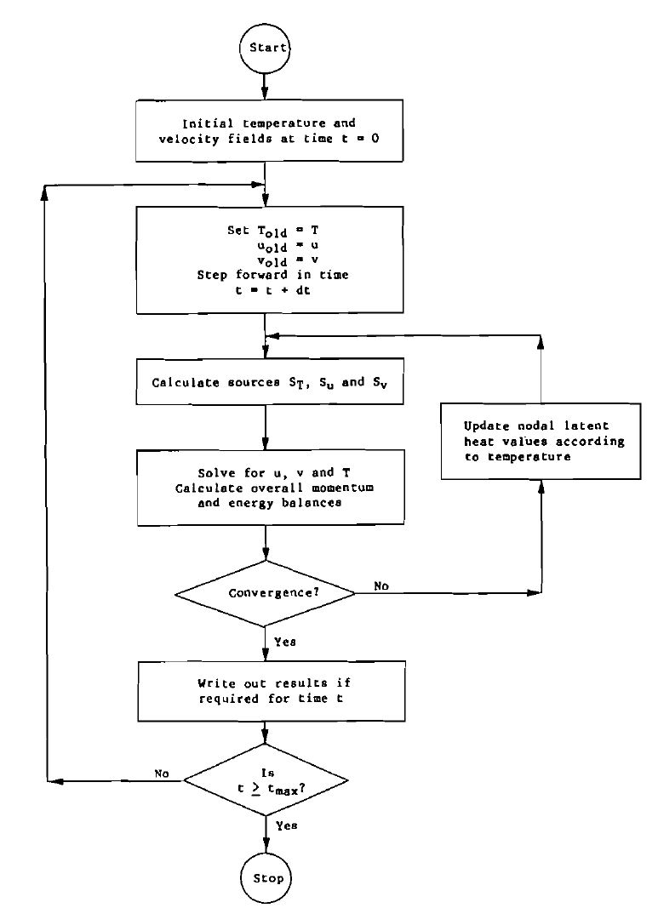
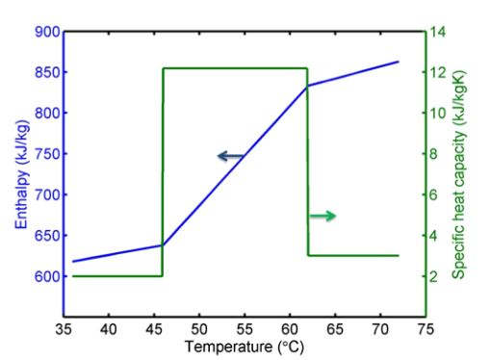
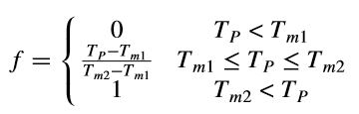
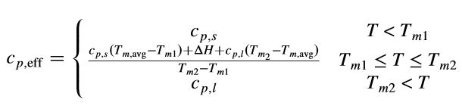
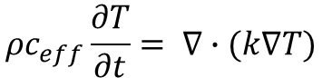
General Scheme
Under-Relaxations
Solver Tolerance Criteria
Momentum | 0.4
Pressure | 0.7
Energy | 0.9
Momentum | 1e-4
Pressure | 1e-3
Energy | 1e-4
Unsteady Energy Balance | 1e-3
Max 100 iterations each per time step
Apparent Heat Capacity formulation
$$ρc_{eff}\frac{∂T}{∂t}= ∇∙(k∇T)$$
T_{m1} , T_{m2} : Melt range
Jackson, et al. J Thermophysics and Heat Transfer,2015
Brent, et al. Num Heat Transfer,1988

Slide 10
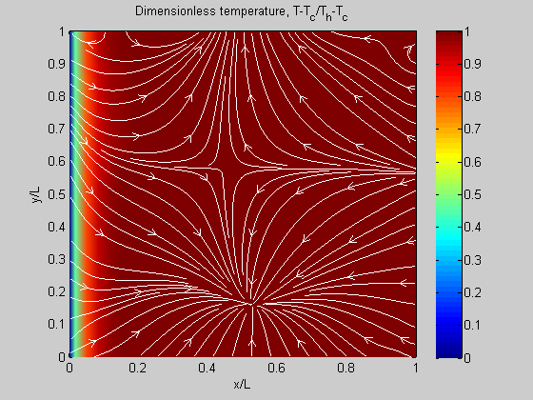
Results
Validated against Voller et al., C=200
Melt front at 100s: 0.183 (ours), 0.194 (theirs)
Video of dimensionless temperature (contour) and velocity streamline.

Slide 11
Accuracy: 100s results
Tolerance for continuity low (p’ = 0.02 for most cases)
Increasing iterations to 1000 does not lower tolerance
Inaccuracy in velocity v term causes convection in solid region
Solved by increasing C by factor of 100
Higher than T_{h} artifact
Velocity inside solid domain because of high tolerance (order of V_{max})

Slide 12
Conclusion
Phase change with convection simulated
Momentum and diffusion coupled
Simulation successfully run
Inaccuracies caused by numerical artifacts
Improvements need to be investigated to lower tolerance values
increasing iterations run does not cause improvement
Increasing C removes velocity from solid region

